Slide 1

GEETHANJALI INSTITUTE OF SCIENCE AND TECHNOLOGY (AUTONOMOUS) GANGAVARAM, KOVUR(M), SPSR Nellore Dist., A.P.
“A COMMUNITY SERVICE PROJECT of AQUA CULTURE”(A11)
PRESTENTED BY :
B.VANDHANA(222U1A3704)
J.SUSHMITHA(222U1A3720)
M.KAVYA(222U1A3729)
P.SHIFAMEHRIN(222U1A3743)
GUIDED BY :
Mr . V . CHAITHANYA Sir (M . Tech)
Assistant Professor

Slide 2
AQUA CULTURE

Slide 3
ABSTRACT
Aquaculture refers to the farming of aquatic organisms such as fish, prawns, crustaceans, mollusks, and aquatic plants, usually for human consumption Aquaculture, the controlled cultivation of aquatic organisms, faces multifaceted challenges. assessing impacts, and designing sustainable practices..

Slide 4
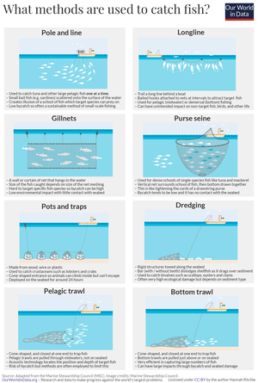
EXISTING SYSTEM
Existing techniques include hand-gathering, spearfishing, netting, angling and trapping. Recreational, commercial and artisanal fishers use different techniques, and also, sometimes, the same techniques. Recreational fishers fish for pleasure or sport, while commercial fishers fish for profit.
Hand-gathering
Spearfishing
Netting
Angling
Line fishing
Rod fishing

Slide 5
ADVANTAGES
Fishing is a renewable resource.
Fishing can provide a source of food and income for fishermen and their families.
Fishing can help maintain the balance of the aquatic ecosystem by controlling populations of certain species.
DISADVANTAGES
Overfishing can lead to the depletion of fish stocks
Pollution from boats, fishing gear, and other sources can damage aquatic ecosystems.
Bycatch (the unintentional capture of non-target species) can lead to the death of other species.

Slide 6
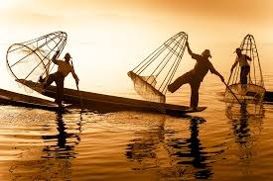
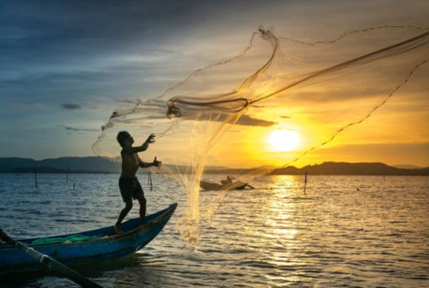
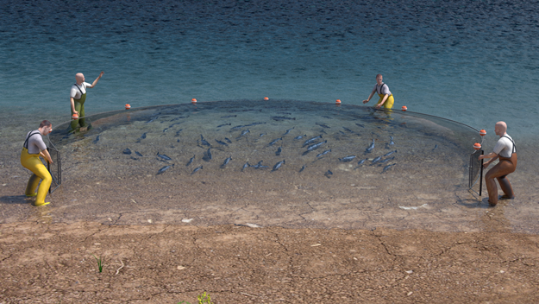
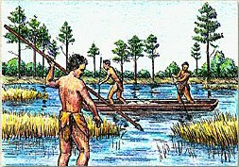
Hand-gathering
Netting
Spearfishing
Rod fishing

Slide 7
PROPOSED SYSTEM
New data processing technologies in fisheries include: big data, block chain, smart weighing at sea, Radio-frequency identification (RFID), smartphones for monitoring, artificial intelligence, drones, and on-board cameras.
Along with this, use of electronic devices like echo sounder, sonar, net sonde, fish aggregating devices (FADs) and global positioning system (GPS) are more recent advancements in the field of fishing technology, providing the fishermen with more accurate information to reach the potential fishing grounds

Slide 8
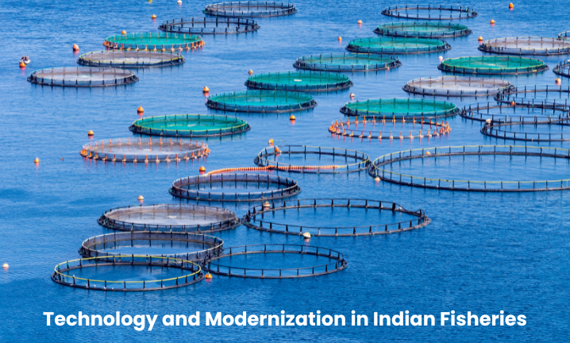
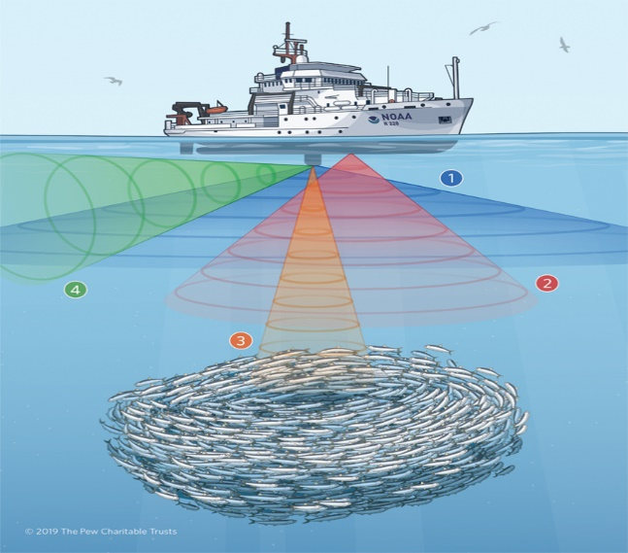
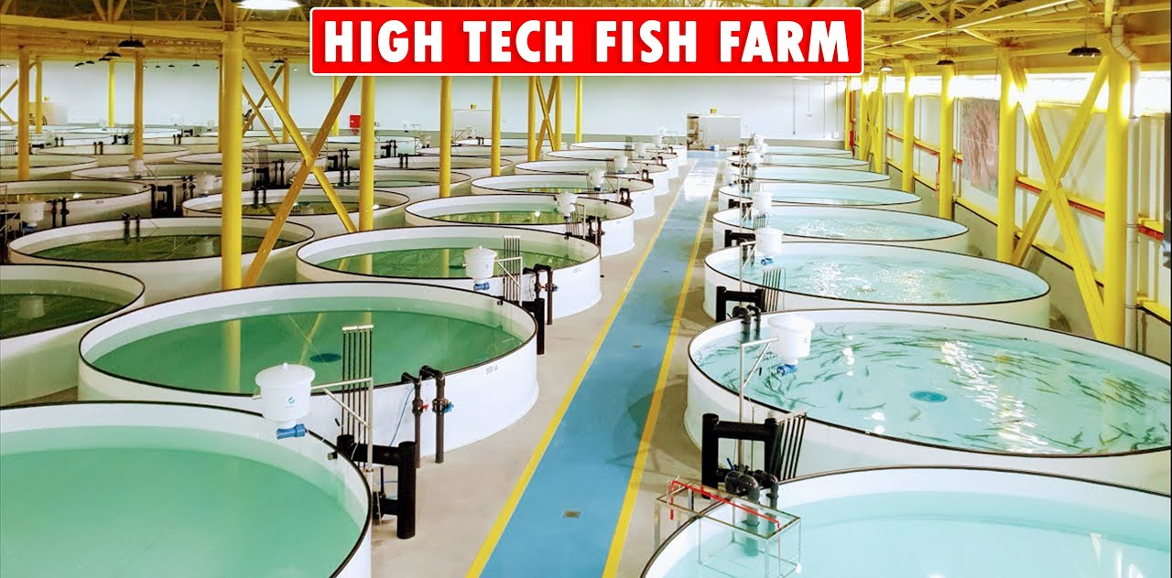
Technology &Modernization in Indian Fisheries
Sonar
High Tech Fish Farm

Slide 9
TYPES OF AQUA CULTURE
FISH CULTIVATION
PRAWN CULTIVATION
MUSSELS
OYSTERS

Slide 10
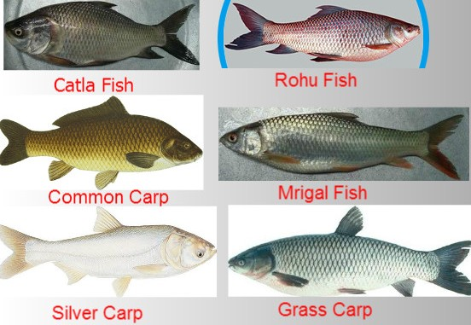
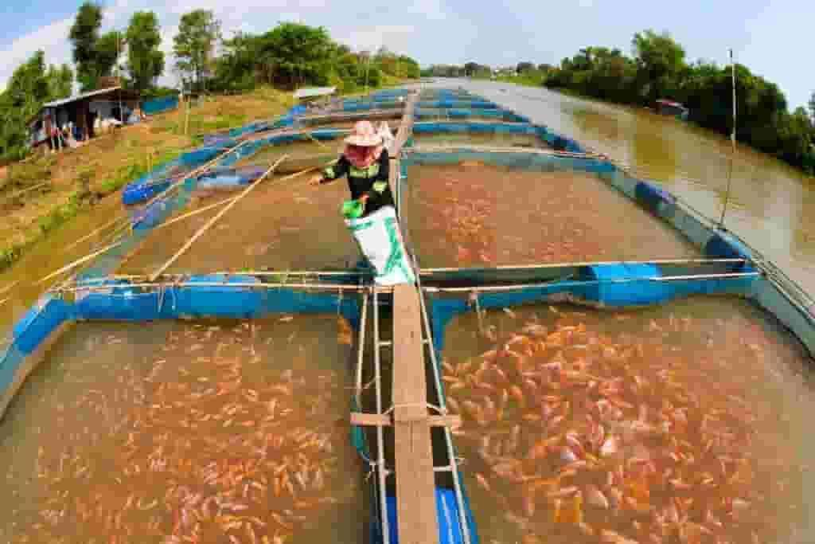
Species Cultivated
The main species cultivated in fishing farming includes:
Worldwide, the most important fish species produced in fish farming are carp, catfish, salmon and tilapia.

Slide 11
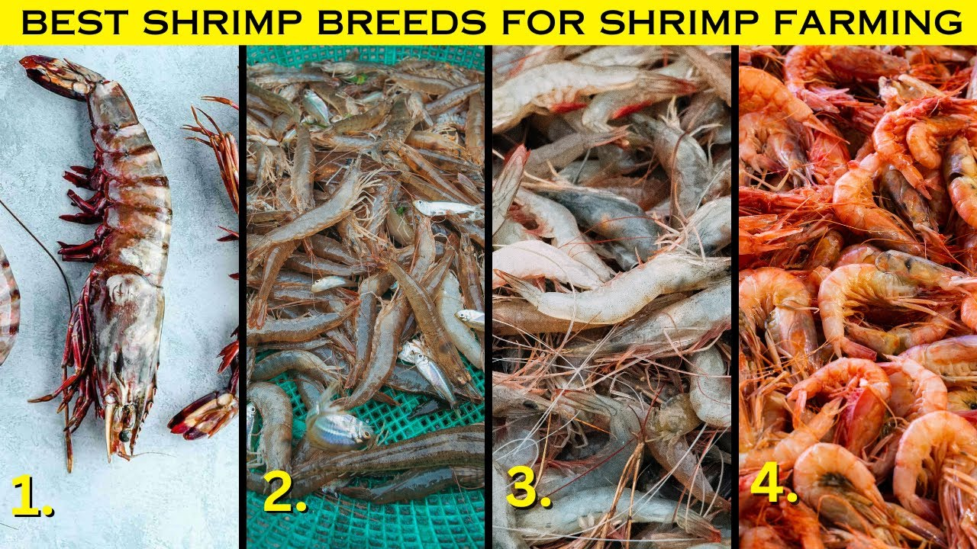
Species Cultivated
The main species cultivated in prawn farming includes:
Freshwater prawn culture involves species like Macrobrachium malcomsonii and Macrobrachium rosenbergii.
prawn

Slide 12
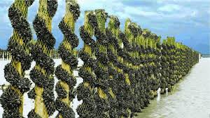
MUSSELS
Mussel is the common name used for members of several families of bivalve molluscs, from saltwater and freshwater habitats. These groups have in common a shell whose outline is elongated and asymmetrical compared with other edible clams, which are often more or less rounded or oval.

Slide 13
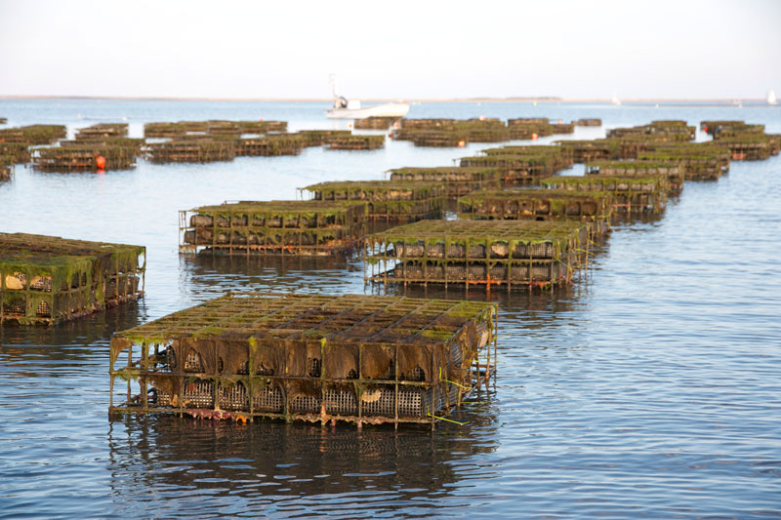
Oyster
Oyster is the common name for a number of different families of salt-water bivalve molluscs that live in marine or brackish habitats. In some species, the valves are highly calcified, and many are somewhat irregular in shape. Many, but not all oysters, are in the superfamily Ostreoidea.

Slide 14
Factors Affecting Cultivation Period:
Water Temperature: Warmer temperatures generally accelerate growth rates, while colder temperatures slow growth.
Feeding Regime: Proper nutrition and feeding practices are crucial for optimal growth and development.
Stocking Density: Higher stocking densities may require longer cultivation periods to reach market size due to competition for resources.
Environmental Conditions: Water quality, salinity, oxygen levels, and disease prevalence can all affect growth rates and cultivation periods.

Slide 15
QUESTIONNAIRE
1. General Information:
1.1 Name:
1.2 Contact Information:
1.3Occupation:
1.4 Location:
2. Experience in Aquaculture:
2.1 How long have you been involved in aquaculture?
2.2 What specific areas of aquaculture are you involved in (fish, prawn)?
2.3 Have you received any formal training or education related to aquaculture?
3. Farm/Facility Details:
3.1 What type of aquaculture operation do you manage or work in?
3.2 What species do you farm or cultivate?
3.3 What is the size and capacity of your aquaculture facility?

Slide 16
4. Challenges and Issues:
4.1 What are the primary challenges you face in your aquaculture operations?
4.2Are there specific environmental or regulatory challenges that impact your operations?
4.3How do you manage disease and health issues in your aquaculture stocks?
5. Technology and Innovation:
5.1What technologies or methods do you use to optimize your aquaculture production?
5.2 Have you adopted any new technologies or innovations recently? If so, how have they impacted your operations?
6.Environmental Impact:
6.1How do you address environmental sustainability in your aquaculture practices?
6.2 What measures do you take to minimize environmental impact (e.g., waste management, water usage)?

Slide 17

7. Market and Economics:
7.1 What are the main markets for your aquaculture products?
7.2 How do you determine pricing and market strategy for your products?
7.3 What economic factors most affect your business?
8. Future Outlook:
8.1 How do you see the future of aquaculture evolving, especially in your region?
8.2 Are there any upcoming trends or developments in aquaculture that you are
preparing for?
9. Personal Insights:
9.1What do you find most rewarding about working in aquaculture?
9.2 What advice would you give to someone looking to start a career in
aqua culture ?

Slide 18
SURVEY AND GEO TAG PICTURES OF SURVEY

Slide 19
SURVEY-1
1.Demographic Information:
Name: M.Lasya
Age: 35
Gender: Female
2. Awareness and Understanding of Aquaculture:
How familiar are you with the concept of aquaculture? (1 = Not familiar at all, 5 = Very familiar)
[ ] 1 [ ] 2 [ *] 3 [ ] 4 [ ] 5
3.Do you believe aquaculture is an important industry for providing seafood to the population?
[* ] Yes [ ] No
4. Do you think aquaculture will become more or less important in global food production in the next decade?
ANS: Important

Slide 20
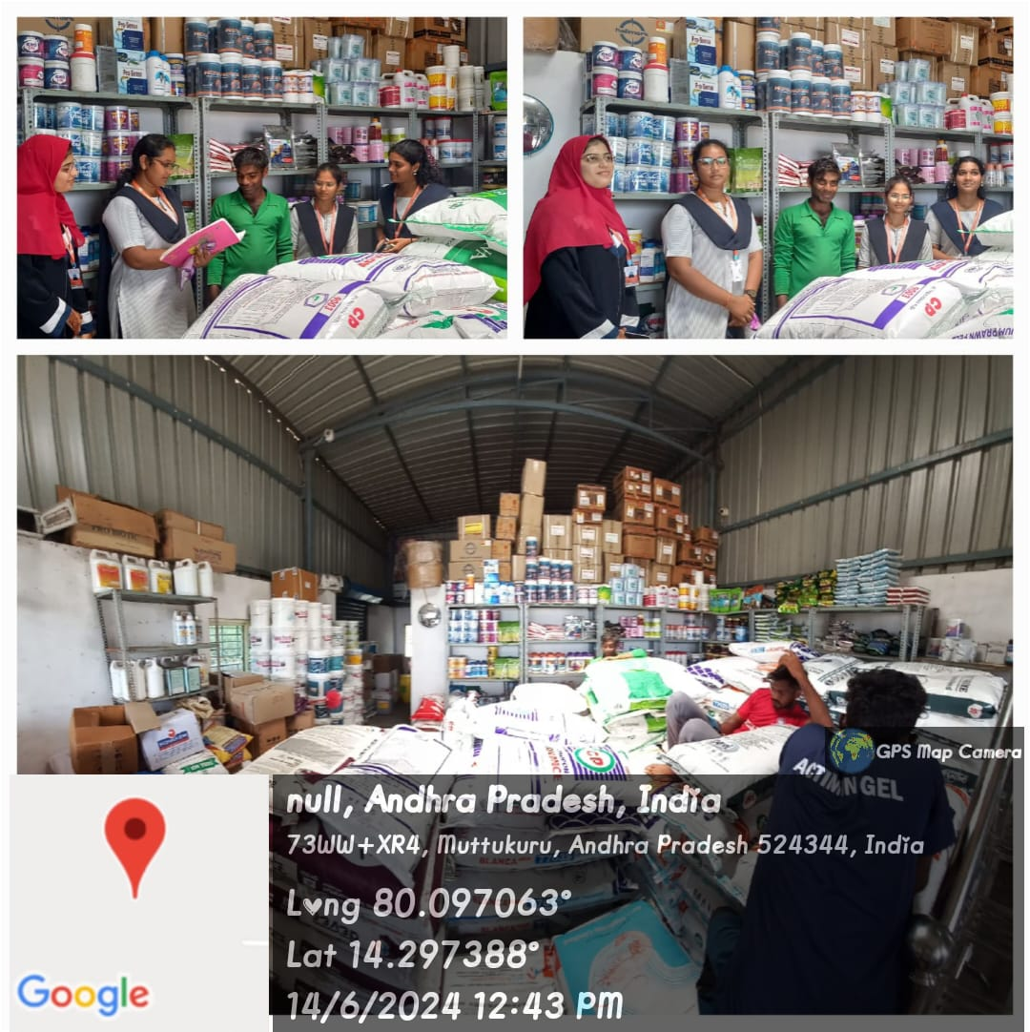
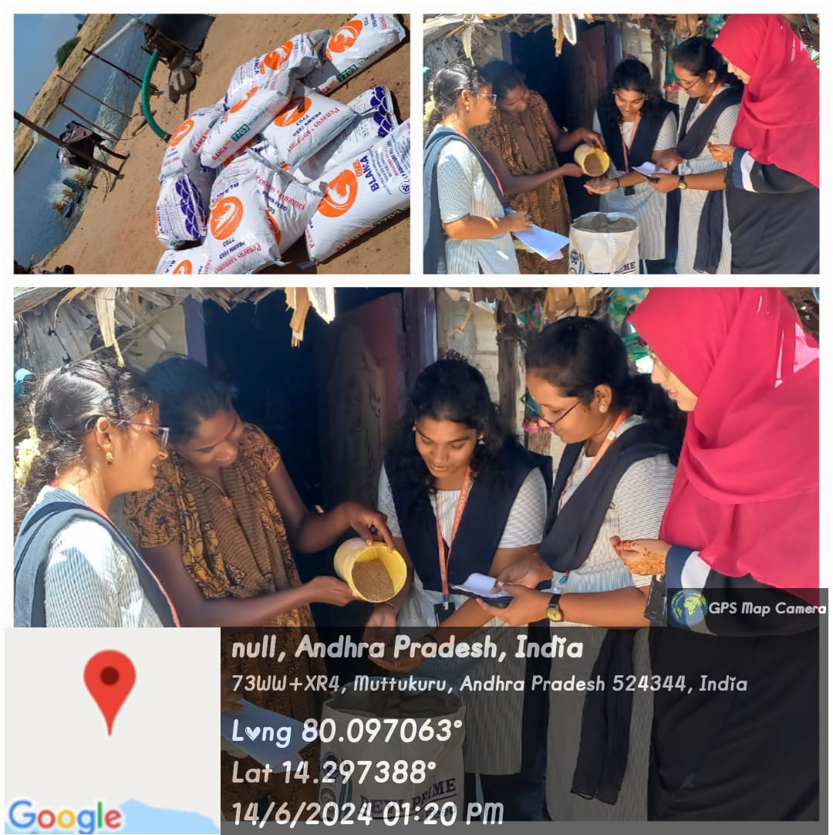
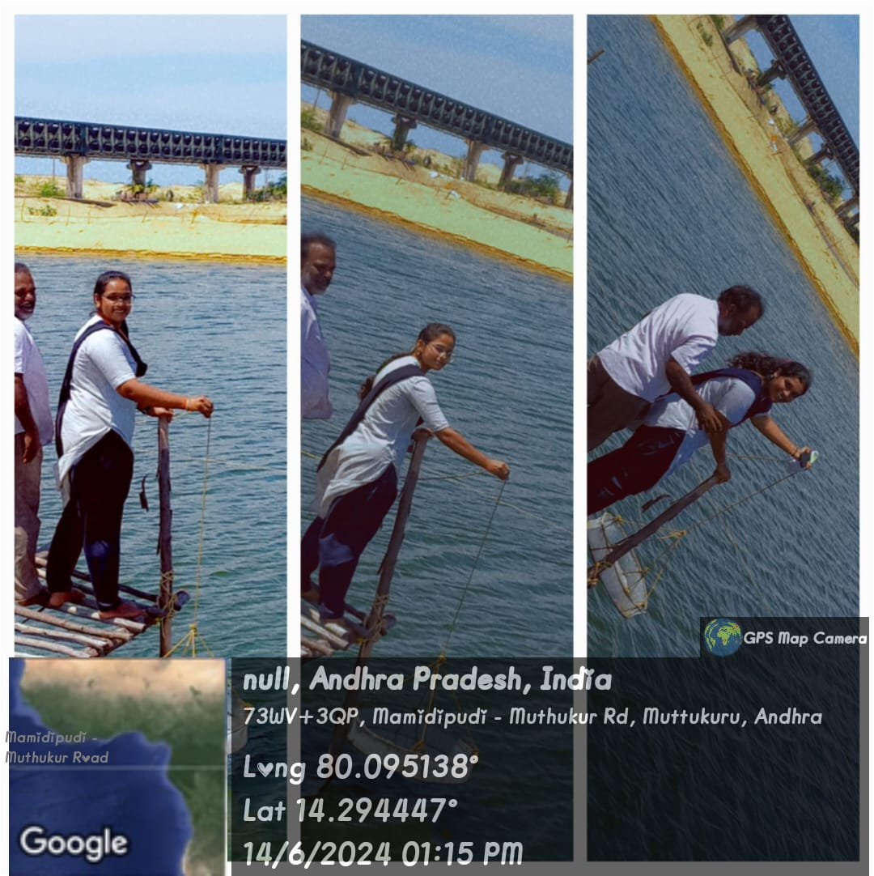
AQUA PHARMACY
M.LASYA
CHECKING PRAWNS

Slide 21
SURVEY-2
1.Demographic Information:
Name: B.Koteswararao
Age: 45
Gender:Male
2.What cultivation are you doing.?
ANS : Prawns
3.Common diseases in prawn cultivation?
ANS: White Spot Syndrome Virus (WSSV),
Taura Syndrome Virus (TSV),
Amoebiasis.
4.Growth of prawn cultivation depends upon.?
ANS: Water Quality,
Feeding and Nutrition,
Disease Management,
Market Demand and Economic Factors,
Skill and Knowledge of Farmers.

Slide 22
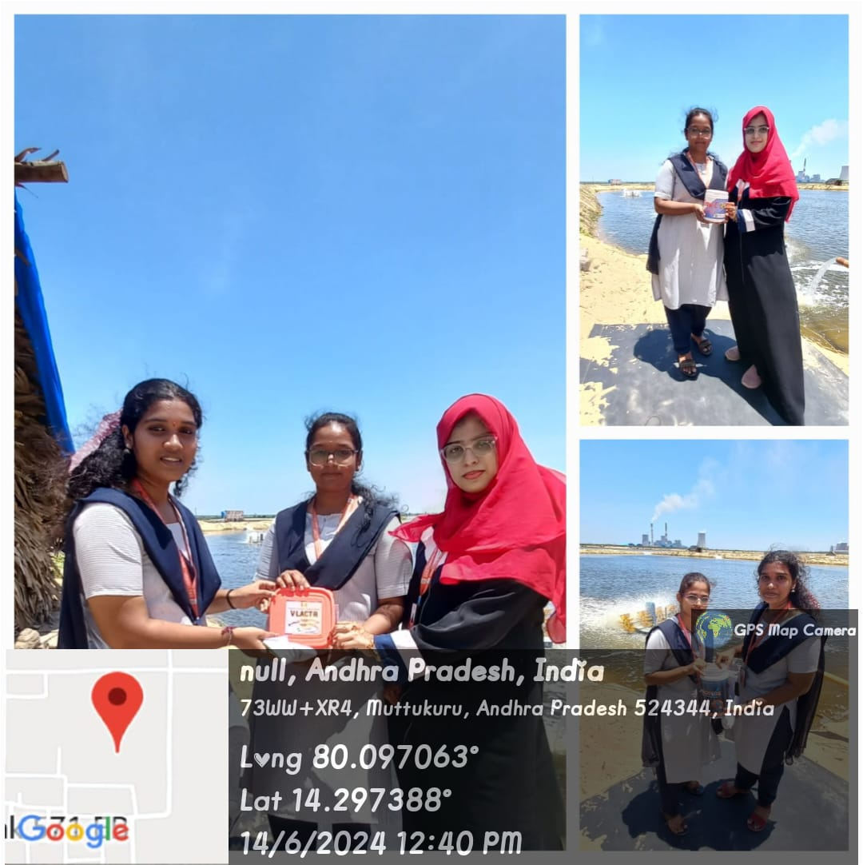
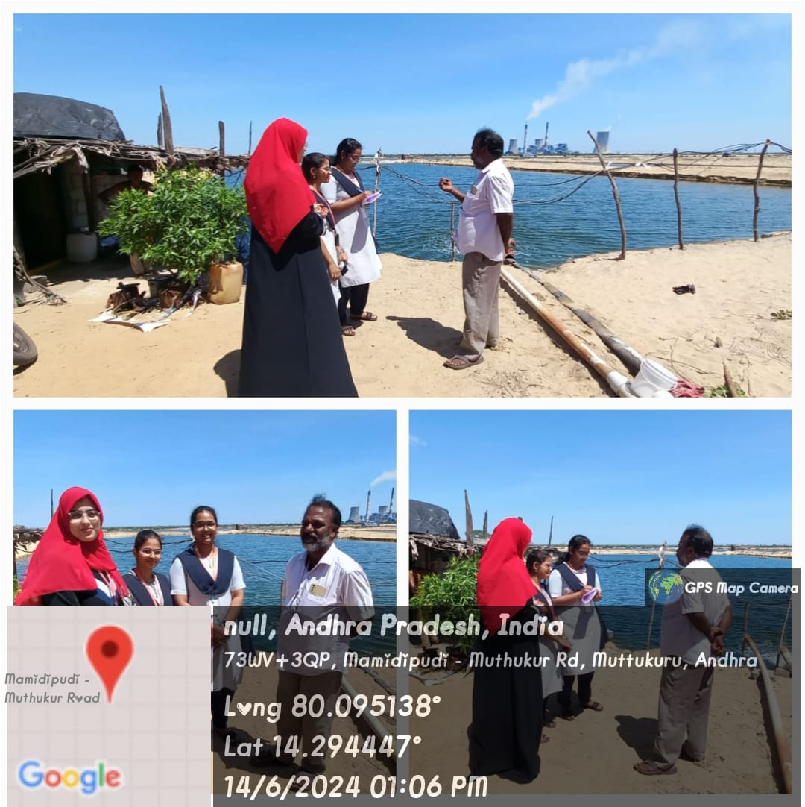
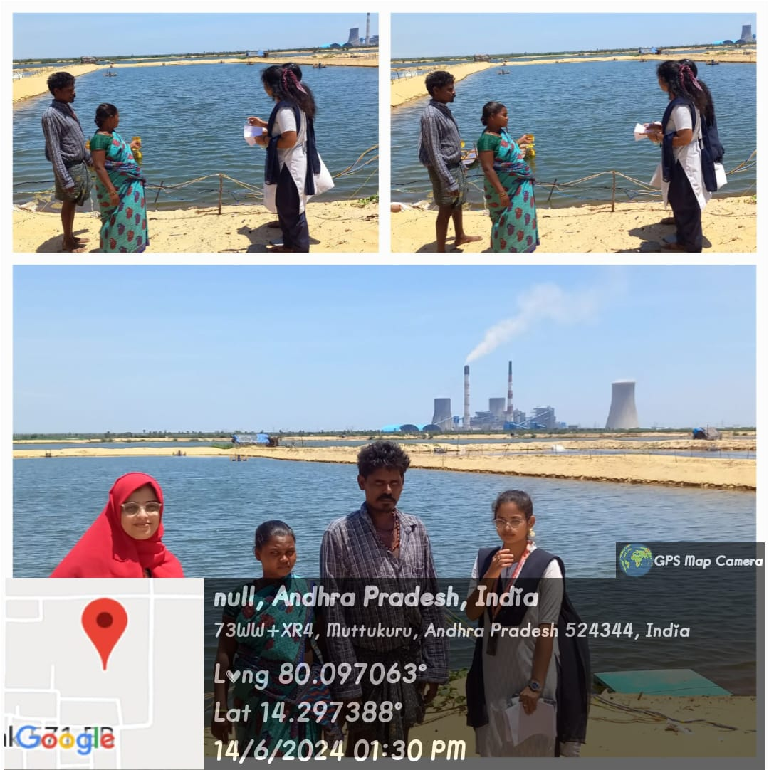
B.KOTESWARARAO
K.SHIVA

Slide 23
SURVEY-3
1.Demographic Information:
Name: K.Shiva
Age: 38
Gender: Male
2.What cultivation are you doing ?
ANS: Fish
3.Common diseases in fish cultivation.?
ANS: Bacterial infections,
Viral infections,
Parasitic infections,
Nutritional diseases.
4.Profit of fish cultivation depends upon.?
ANS: Market demand and prices
Production costs
Feed efficiency and conversion ratio

Slide 24
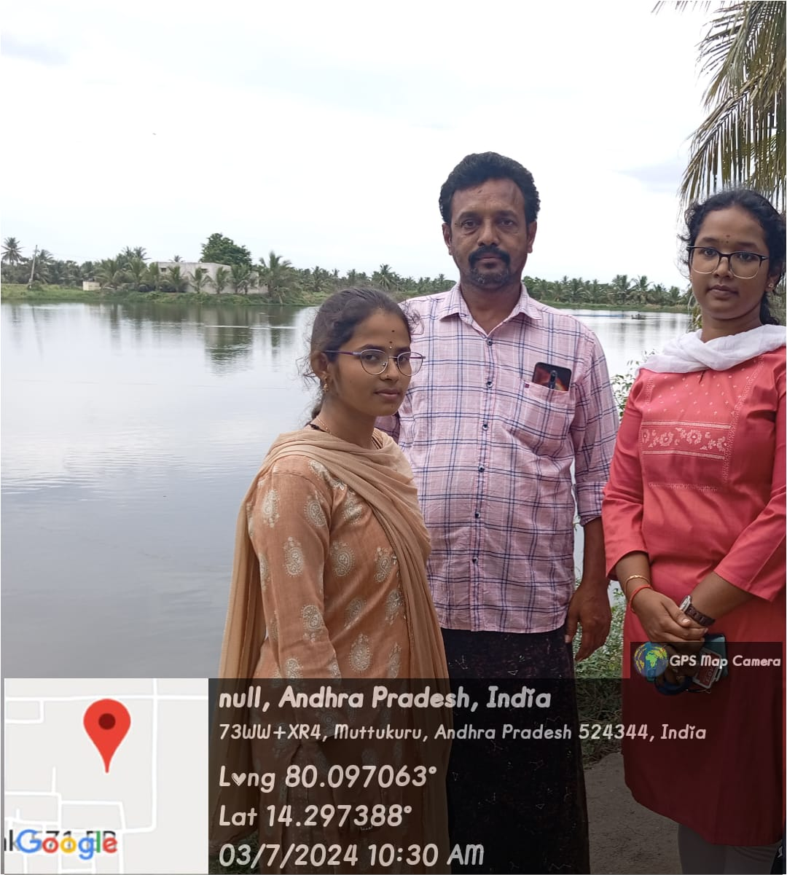
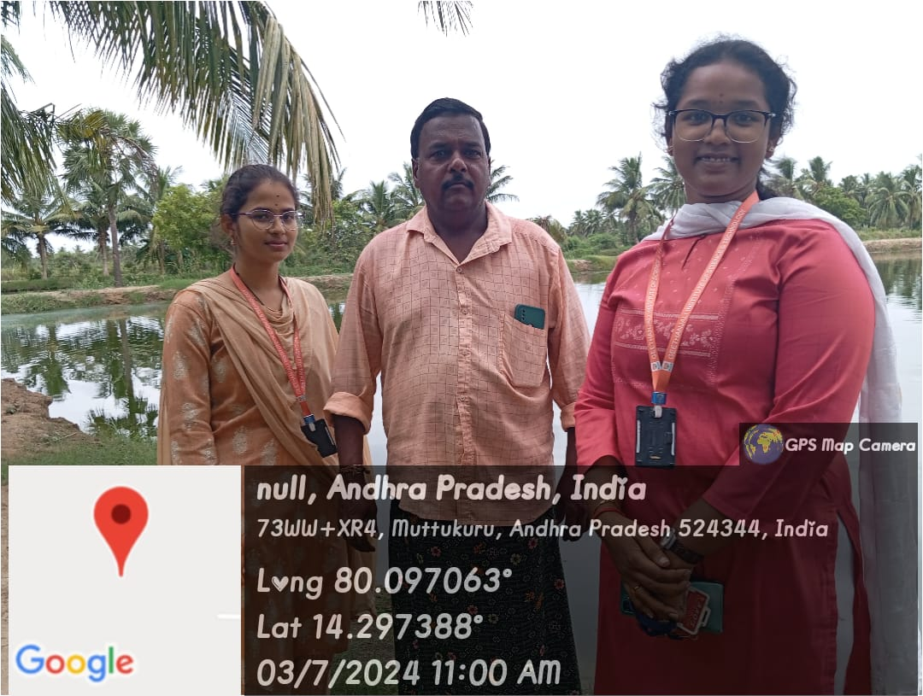
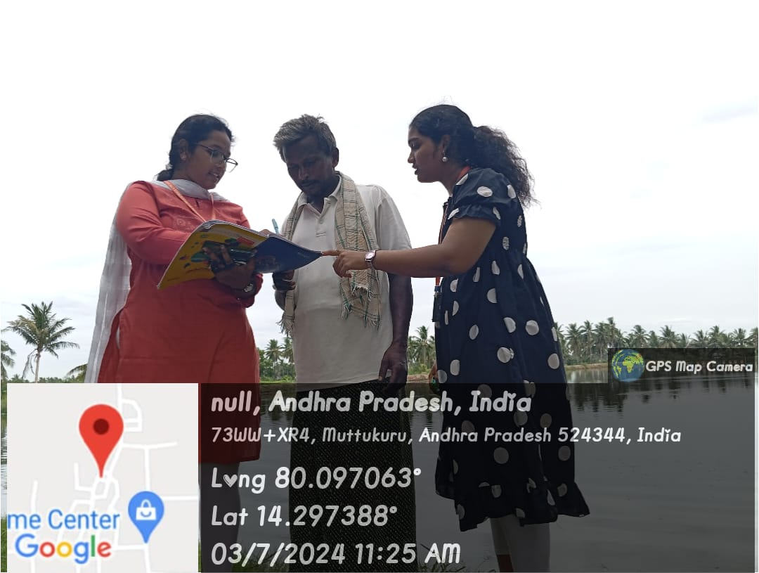
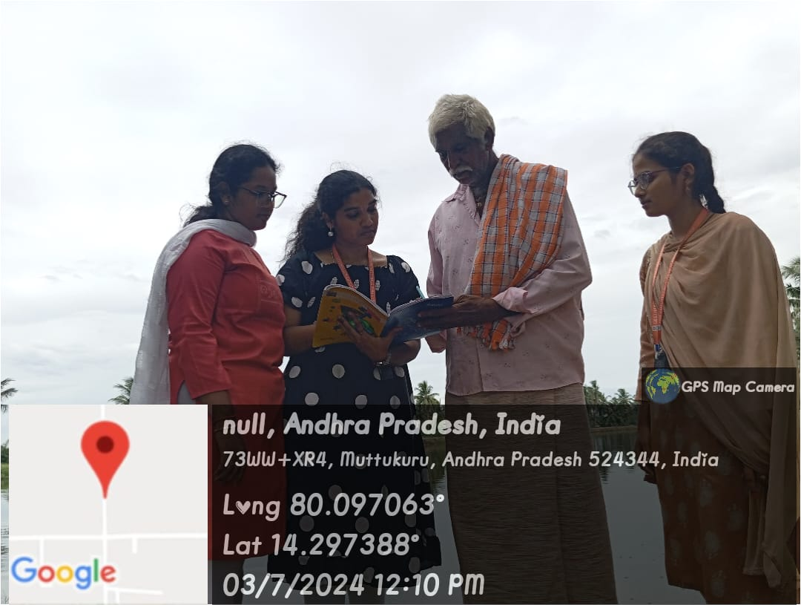

Slide 25
SURVEY-4
1.Demographic Information:
Name: B.Jyothi
Age: 40
Gender: Female
2.What cultivation are you doing ?
ANS: Prawn
3.Common diseases in fish cultivation.?
ANS: Bacterial infections,
Viral infections,
Parasitic infections,
Nutritional diseases.
4.Profit of fish cultivation depends upon.?
ANS: Market demand and prices

Slide 26
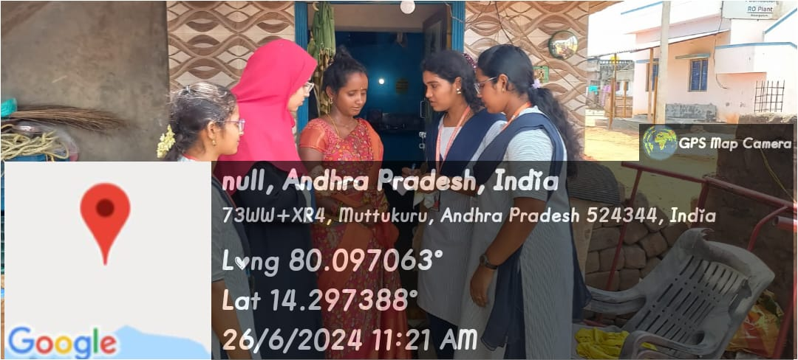
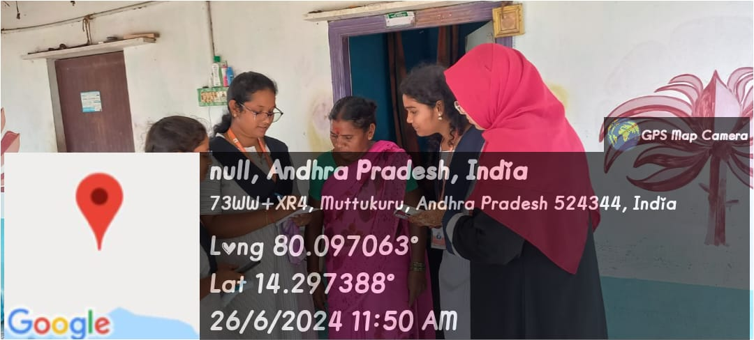
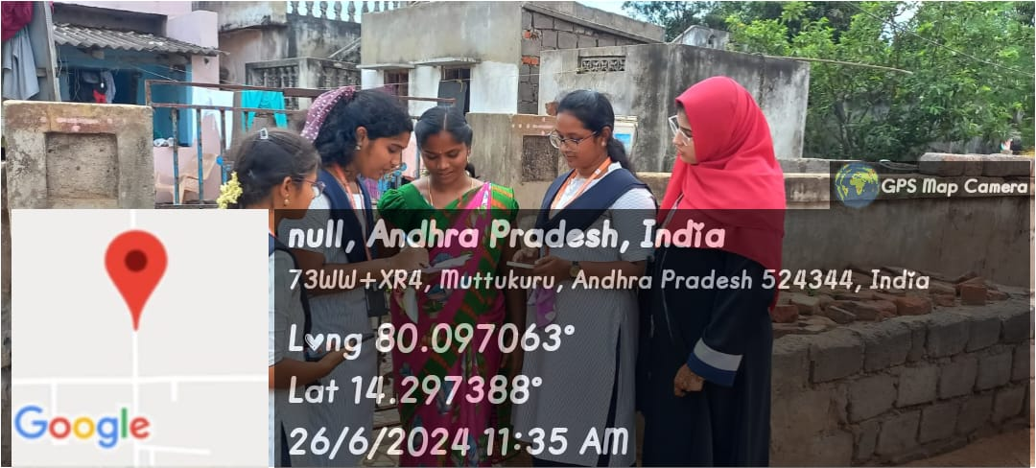

Slide 27
SURVEY-5
1.Demographic Information:
Name: G . Narayana
Age: 43
Gender : Male
2.What cultivation are you doing.?
ANS : Fish
3.Common diseases in prawn cultivation?
ANS: White Spot Syndrome Virus (WSSV),
Taura Syndrome Virus (TSV),
Amoebiasis.
4.Growth of prawn cultivation depends upon.?
ANS: Water Quality,
Feeding and Nutrition,
Disease Management,
Market Demand and Economic Factors,
Skill and Knowledge of Farmers.

Slide 28
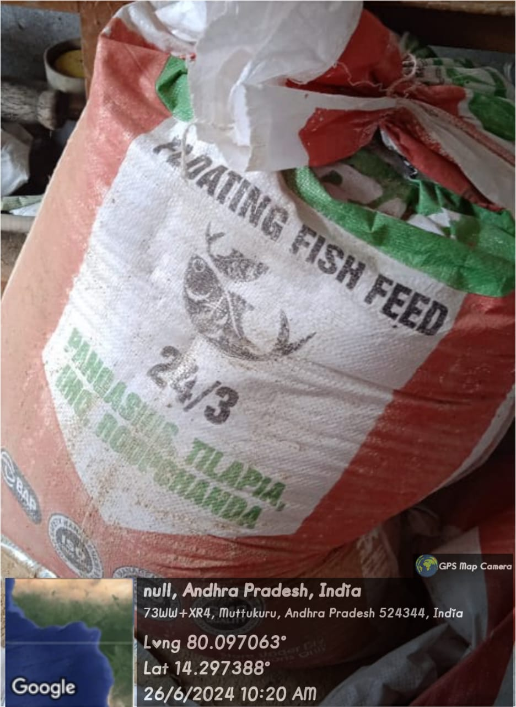
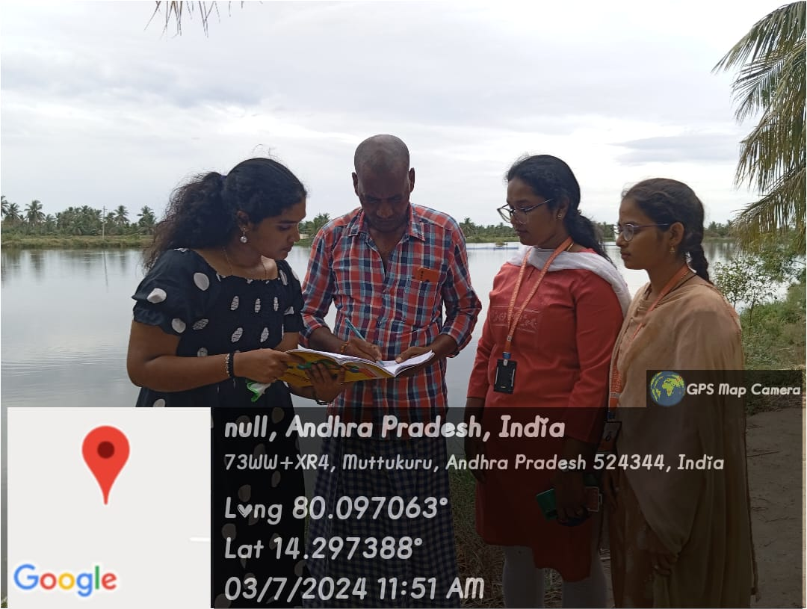
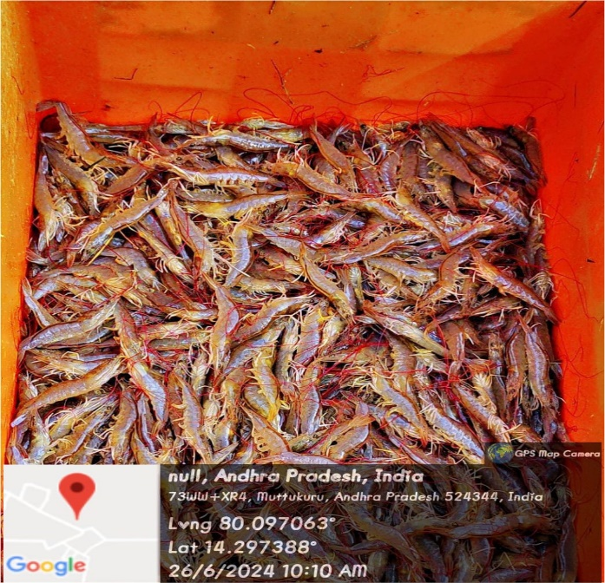

Slide 29
SURVEY-6
1.Demographic Information:
Name: N.Ramana
Age: 55
Gender: Male
2. Awareness and Understanding of Aquaculture:
How familiar are you with the concept of aquaculture? (1 = Not familiar at all, 5 = Very familiar)
[ ] 1 [ ] 2 [ *] 3 [ ] 4 [ ] 5
3.Do you believe aquaculture is an important industry for providing seafood to the population?
[* ] Yes [ ] No
4. Do you think aquaculture will become more or less important in global food production in the next decade?
ANS: Important

Slide 30
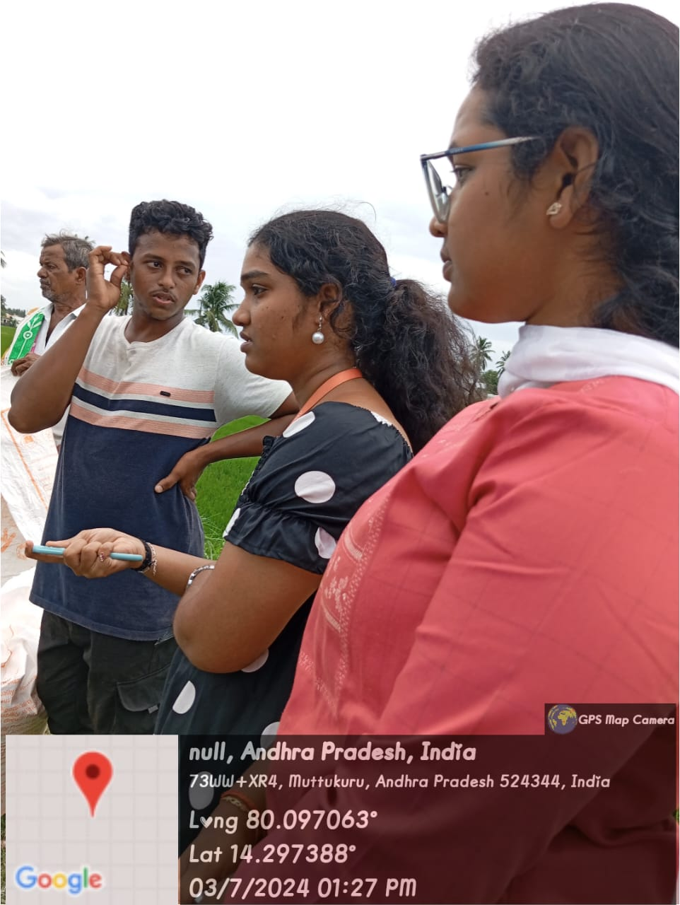
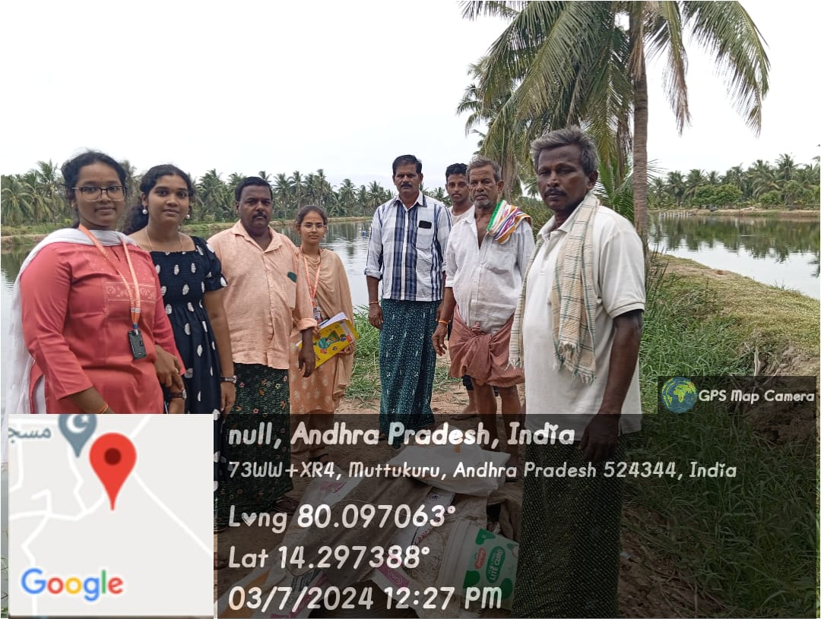

Slide 31
SURVEY-7
1.Demographic Information:
Name: A.Seethayya
Age: 41
Gender: Male
2.What cultivation are you doing ?
ANS: Fish
3.Common diseases in fish cultivation.?
ANS: Bacterial infections,
Viral infections,
Parasitic infections,
Nutritional diseases.
4.Profit of fish cultivation depends upon.?
ANS: Market demand and prices

Slide 32
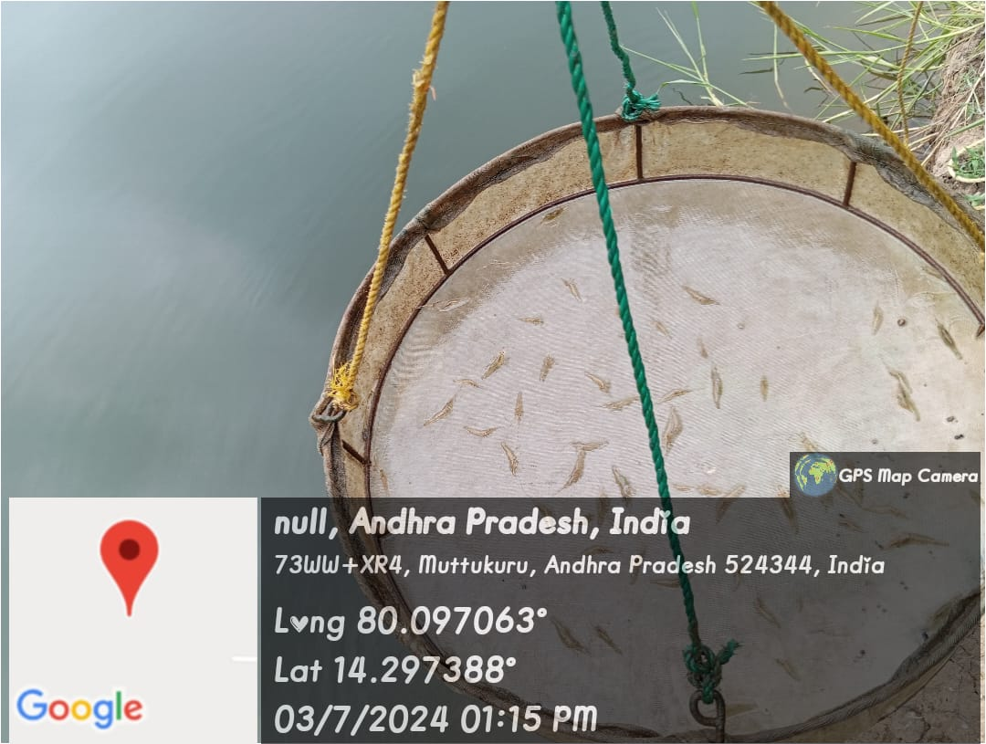

Slide 33
WEEKLY REPORT
Objectives of the Activity Done
Detailed Report
We visited a village and observed all the schools ,Markets , sachivalayam organizations etc.
We went to and approached the officers to get the permission to do survey in their village.
We also asked the permission from the farmers to do survey in their field and we observed that aquaculture is most commonly grown. We asked many questions about their aquaculture and the problems occurring in their aquaculture , we met many farmers and asked about their ponds.

Slide 34
ACTIVITY LOG
WEEK | Brief description of the week activity | Learning Outcomes
Week-1 | Prepared map of the village and conducted survey | Learned the possible route ways for village and observed the daily activities.
Week-2 | Prepared over view of the ponds | Observed the Fish ponds and Prawn ponds in the village.
Week-3 | Prepared map of problems identification | Problem identification and discussion.
Week-4 | Prepared transact map of village | Collected the information on the fish ponds and prawn ponds.
Week-5 | Prepared a chart about aqua culture to create awareness | Awareness created on the Aqua culture.
Week-6 | Learned required technology and implementation of project | Preparation of complete documentation

Slide 35


Slide 36


